Slide 1


CHIN 9506
Tue: 10:30am-12:20pm
Thur: 10:30am- 12:20pm

Slide 2


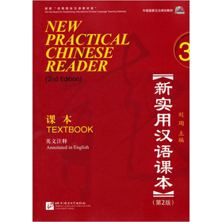
Qualifications
1.New Practical Chinese Reader Book1, 2 & 1st half of Book3
2. CHIN 9505
3.HSK Level 4

Slide 3

Enrollment
1. Online Registration
2. Pre-course Test
3. Statement of Proficiency
Approved by teacher

Slide 4

Expected Learning Outcome
1. Demonstrate your ability to communicate effectively in sophisticated Chinese with correct pronunciation.
2. Demonstrate mastery of another most frequently used Chinese characters(300) , in addition to Chinese characters(1500) and core sentences(150) acquired in previous courses.
3. Demonstrate the ability to communicate in speech and writing, using around 500 characters to discuss various topics.

Slide 5


Topics of CHIN9506
Lesson33: Environmental protection

Slide 6

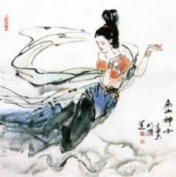
Topics of CHIN9506
Lesson34: The legend in Chinese

Slide 7

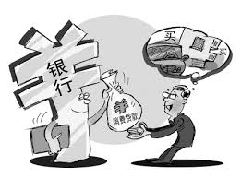
Topics of CHIN9506
Lesson35: Consumption of Chinese people

Slide 8

Topics of CHIN9506
Lesson36: Climate of China

Slide 9

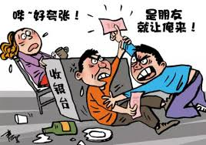
Topics of CHIN9506
Lesson37: The culture of “paying the bill” in China

Slide 10


Topics of CHIN9506
Lesson38: Marriage customs in China

Slide 11

For each chapter, we will learn……
Vocabularies
Texts
Grammar
Drills and practice

Slide 12




We will enjoy Chinese Videos & Movies:

Slide 13

Assessment methods | Weighting
1. Quiz | 10%
2. Workbook | 10%
3. Worksheet | 10%
4. Presentation | 10%
5. Essay | 10%
6. Movie review | 10%
7. Mid-term test | 20%
8. Final test | 20%

Slide 14

Contact me……
Ms. Jin Jian 靳老师
jjin@hku.hk
Office：
Rm 708, Run Run Shaw Tower, Centennial Campus

